Slide 1

Objective 1.3: Outline the functions and uses of primary storage devices
Content:
PROM, EPROM, RAM, ROM

Slide 2
ROM – Read Only Memory
Type of computer memory that can only be read to and no written to

Slide 3
PROM – Programmable Read Only Memory
This type of ROM can be programmed only once using special equipment. It is useful for companies that want to make their own ROMs from software they write themselves. If they change their code they can create new PROMs without requiring a ROM manufacturer.

Slide 4
EPROM
This type of ROM can be erased and reprogrammed, which makes it more useful than a PROM. EPROM chips are programmed in the same way as PROM chips. Data is erased from this chip by exposing it to ultraviolet light of a specific frequency for a specified period of time.

Slide 5

Objective 1.3: Outline the functions and uses of primary storage devices
Content:
- Bistable devices - bit - byte - kilobyte - megabyte - gigabyte - terabyte - word - size

Slide 6
Bistable
Components that make up memory can be set to one of two states either on or off. This is what is meant by Bistable.
bistable devices is what makes up memory.
These two states are represented using binary digits - 0 for off and 1 for on.
As such, the smallest unit of storage of memory is called a binary digit (bit). The amount of data and instructions that can be stored in primary storage or secondary storage media is measured in bytes.

Slide 7
Byte
A byte is made up of a combination of 8 bits and has the capacity to represent one character i.e. a letter, a number, a symbol, a punctuation mark or a blank space.

Slide 8
Word
A word is the number of bits the computer can process in one operation.
Word Size
A word size or word length is the number of bits in a word.

Slide 9
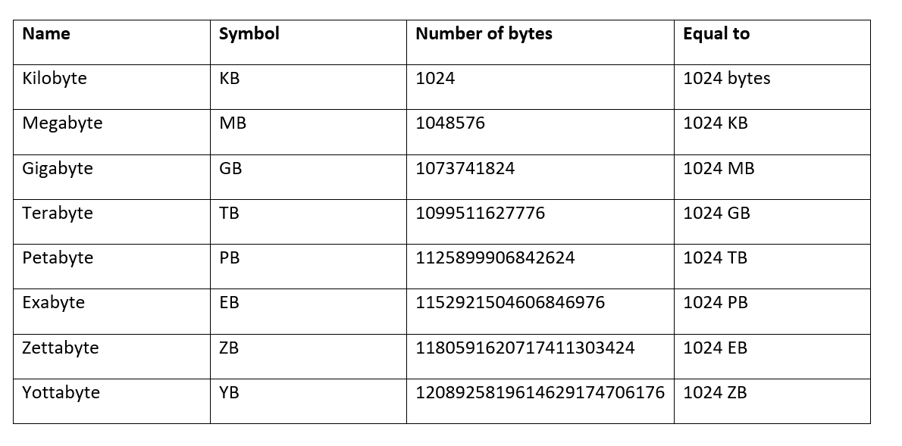
Variety of storage sizes

